Slide 1

Unit-2 Transportation Model
Operation Research
(OR)
#2301CS729
Prof. Bhavin J Vegada
Department of Mechanical Engineering
bhavin.vegada@darshan.ac.in
9825366601

Slide 2
Course Outline
Introduction to Transportation Model
Initial Feasible Solution of Transportation Problem
Solution using North-West Corner (NWC) Method
Solution using Least Cost Method (LCM)
Solution using Vogel’s Approximation (VAM) Method
Optimal Solution of Transportation Problem
Solution using Stepping Stone Method
Solution using Modified Distribution (MODI) Method
Variations in Transportation Problem
Unbalanced Transportation Problem
Problem with Degeneracy at Initial Solution Level
Problem with Degeneracy at Optimal Solution Level
Restricted Route Problem
Maximization Problem

Slide 3
Introduction to Transportation Model
Section – 2.1

Slide 4
Transportation Model
Transportation model is one of the special type of linear programming problem.
It was developed for optimum distribution of a product/commodity from several sources (factories) to various destinations (warehouses), so it is called the transportation problem.
The transportation model can be used for a wide variety of situations such as:
Scheduling
Production
Investment
Plant Visits
Inventory Control
Employment Schedule
Personnel Assignment
Product Mix Problems
and many more…
Hence, the transportation model is not confined to transportation or distribution only.

Slide 5


Transportation Model
Manufacturing Unit
Warehouses

Slide 6
Assumptions in the Transportation Model
Total quantity of the item/product available at different sources is equal to the total requirements at different destinations. i.e. Supply = Demand.
Items can be transported conveniently from all sources to destinations.
The unit transportation cost of the item from all sources to destinations is certainly and precisely known.
The transportation cost on a given route is directly proportional to the number of units shipped on that route.
The objective is to minimize total transportation cost for the organization as a whole and not for the individual supply and distribution centers.

Slide 7
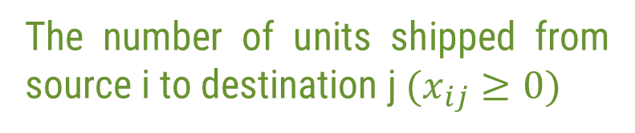
Mathematical Model of Transportation Problem
Destinations
Source = i (where, i = 1, 2, …, m)
…
1
2
n
Supply
x₁₁
x₁₂
x_{1n}
Destination = j (where j = 1, 2, …, n)
…
a₁
1
a_{i} =
The number of supply units available at source i
C₁₁
C₁₂
C_{1n}
x₂₁
x₂₂
x_{2n}
2
…
a₂
Sources
or
Origins
b_{j} =
The number of demand units required at destination j
C₂₁
C₂₂
C_{2n}
…
…
…
…
…
…
C_{ij} =
The unit transportation cost for transporting the units from source i to destination j
x_{m1}
x_{m2}
x_{mn}
…
a_{m}
m
C_{m1}
C_{m2}
C_{mn}
x_{ij} =
The number of units shipped from source i to destination j $(x_{ij}≥0)$
Demand
b₁
b₂
…
b_{n}

Slide 8
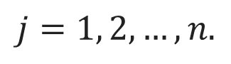
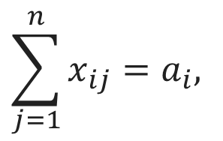
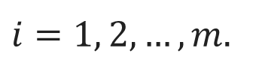
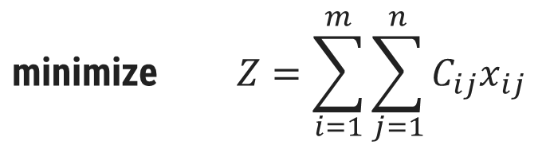
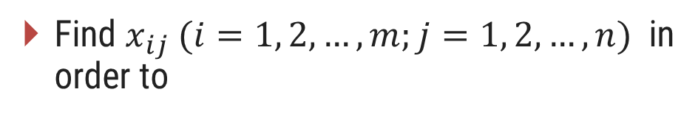
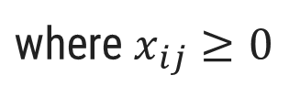
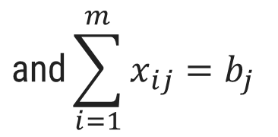
Mathematical Model
Find $x_{ij} (i=1, 2,…,m;j=1, 2,…,n)$ in order to
$$\text{minimize} Z=\sum_{i=1}^{m}{\sum_{j=1}^{n}{C_{ij}x_{ij}}}$$
Destinations
Objective
Function
1
2
n
Supply
x₁₁
x₁₂
x_{1n}
…
a₁
Sources or Origins
1
Subject to
C₁₁
C₁₂
C_{1n}
$$\sum_{j=1}^{n}{x_{ij}}=a_{i},$$
x₂₁
x₂₂
x_{2n}
2
…
a₂
$$i=1, 2,…,m.$$
C₂₁
C₂₂
C_{2n}
Availability
Constraints
$$\text{and}\sum_{i=1}^{m}{x_{ij}}=b_{j}$$
…
…
…
…
…
…
$$j=1, 2,…,n.$$
x_{m1}
x_{m2}
x_{mn}
…
a_{m}
Requirement
Constraints
m
C_{m1}
C_{m2}
C_{mn}
$$\text{where} x_{ij}≥0$$
…
Demand
b₁
b₂
b_{n}

Slide 9




Solution of a Transportation Problem
1
3
Obtain Initial Feasible Solution
Revise the Solution
(until an optimum solution reached)
If Not Optimum
Check Optimality
(by determining Opportunity Cost)
2
Methods to find Initial Solution:
North-West Corner (NWC) Method
Least Cost Method (LCM)
Vogel’s Approximation Method (VAM)
Exit
Optimum Solution Reached
Methods to find Optimum Solution:
Stepping Stone Method
Modified Distribution (MODI) Method
If Optimum

Slide 10
Initial Feasible Solution of Transportation Problem
Section – 2.2

Slide 11
Steps to Find Initial Solution of Transportation Problem
Step-1
Step - 2
Step - 3
Check the given problem is balanced or not, if not then make it balanced.
Calculate total supply and total demand.
Prepare transportation table.
Step - 4
Find out initial solution by given method.

Slide 12
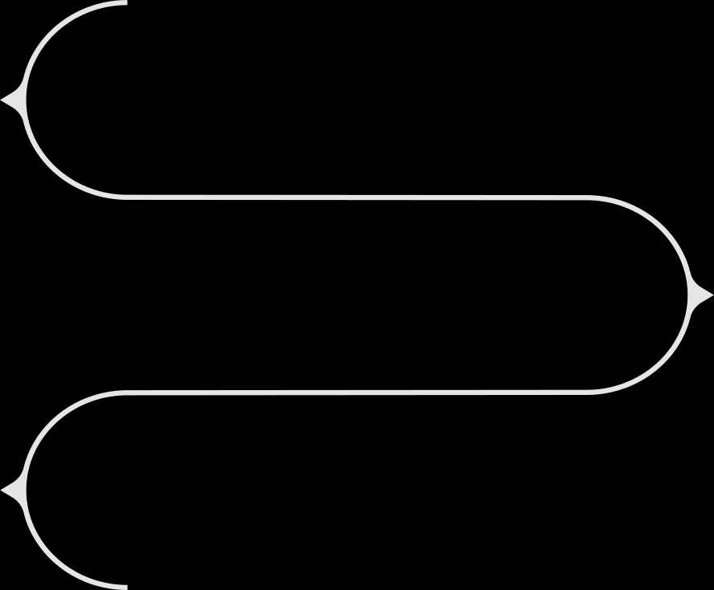




Steps to Find Initial Feasible Solution of Transportation Problem
01
Supply - Demand
Calculate total supply and total demand
Balance the Demand & Supply
02
Check the given problem is balanced or not, if not then make it balanced.
03
Transportation Table
Prepare the transportation table
Initial Solution
04
Find out initial solution by the given method

Slide 13
Problem 1
A firm owns facilities at seven places. It has manufacturing plants at places A, B and C with daily output of 500, 300 and 200 units of an item respectively. It has warehouses at places P, Q, R and S with daily requirements of 180, 150, 350 and 320 units respectively. Per unit shipping charges on different routes are given here:
To: | P | Q | R | S
From A: | 12 | 10 | 12 | 13
From B: | 7 | 11 | 8 | 14
From C: | 6 | 16 | 11 | 7
The firm wants to send the output from various plants to warehouses. Obtain Initial Feasible Solution by: North-West Corner Method (NWC Method).

Slide 14
Problem 1: Initial Solution by North-West Corner(NWC) Method
First check if the given problem is balanced by calculating total supply and total demand.
To
P
Q
R
S
Supply
Supply
A – 500
B – 300
C – 200
1000
Demand
P – 180
Q – 150
R – 350
S – 320
1000
N
From
180
150
170
500
320
A
12
10
12
13
170
0
W
E
180
120
300
120
B
7
11
8
14
0
200
200
0
S
C
6
16
11
7
180
0
150
0
350
180
320
200
Total supply and total demand are equal so the given problem is balanced and we can find the initial solution.
Demand
0
0
To: | P | Q | R | S
From A: | 12 | 10 | 12 | 13
From B: | 7 | 11 | 8 | 14
From C: | 6 | 16 | 11 | 7

Slide 15
Problem 1: Initial Solution by North-West Corner(NWC) Method
Initial Solution obtained by North-West corner method:
To
P
Q
R
S
Supply
From
180
150
170
500
320
A
12
10
12
13
170
0
180
120
300
120
B
7
11
8
14
0
200
200
0
C
6
16
11
7
180
0
150
0
350
180
320
200
Demand
0
0
Transportation Cost:
= (12x180)
+ (10x150)
+ (12x170)
+ (8x180)
+ (14x120)
+ (7x200)
= ₹10,220

Slide 16
Problem 1
A firm owns facilities at seven places. It has manufacturing plants at places A, B and C with daily output of 500, 300 and 200 units of an item respectively. It has warehouses at places P, Q, R and S with daily requirements of 180, 150, 350 and 320 units respectively. Per unit shipping charges on different routes are given here:
To: | P | Q | R | S
From A: | 12 | 10 | 12 | 13
From B: | 7 | 11 | 8 | 14
From C: | 6 | 16 | 11 | 7
The firm wants to send the output from various plants to warehouses. Obtain Initial Feasible Solution by: Least Cost Method (LCM).

Slide 17
Problem 1: Initial Solution by Least Cost Method (LCM)
First check if the given problem is balanced by calculating total supply and total demand.
To
P
Q
R
S
Supply
Supply
A – 500
B – 300
C – 200
1000
Demand
P – 180
Q – 150
R – 350
S – 320
1000
From
150
50
300
500
350
A
12
10
12
13
300
0
300
300
0
B
7
11
8
14
180
20
200
20
C
6
16
11
7
0
180
0
150
0
350
50
320
300
Total supply and total demand are equal so the given problem is balanced and we can find the initial solution.
Demand
0
0
❑
If the minimum cost is not unique, select the cell where the highest units can be allocated.

Slide 18
Problem 1: Initial Solution by Least Cost Method (LCM)
Initial Solution obtained by Least Cost Method:
To
P
Q
R
S
Supply
From
150
50
300
500
350
A
12
10
12
13
300
0
300
300
0
B
7
11
8
14
180
20
200
20
C
6
16
11
7
0
180
0
150
0
350
50
320
300
Demand
0
0
Transportation Cost:
= (10x150)
+ (12x50)
+ (13x300)
+ (8x300)
+ (6x180)
+ (7x20)
= ₹9,620

Slide 19
Problem 1
A firm owns facilities at seven places. It has manufacturing plants at places A, B and C with daily output of 500, 300 and 200 units of an item respectively. It has warehouses at places P, Q, R and S with daily requirements of 180, 150, 350 and 320 units respectively. Per unit shipping charges on different routes are given here:
To: | P | Q | R | S
From A: | 12 | 10 | 12 | 13
From B: | 7 | 11 | 8 | 14
From C: | 6 | 16 | 11 | 7
The firm wants to send the output from various plants to warehouses. Obtain Initial Feasible Solution by: Vogel’s Approximation Method(VAM).

Slide 20
Problem 1: Initial Solution by Vogel’s Approximation Method (VAM)
Vogel’s approximation method is also known as penalty method or regret method.
First check if the given problem is balanced by calculating total supply and total demand.
Supply
A – 500
B – 300
C – 200
1000
Demand
P – 180
Q – 150
R – 350
S – 320
1000
Total supply and total demand are equal so the given problem is balanced and we can find initial solution.

Slide 21
Problem 1: Initial Solution by Vogel’s Approximation Method (VAM)
Initial Solution by Vogel’s Approximation Method:
Transportation Cost:
To
= (10x150)
+ (12x230)+
(13x120)
P
Q
R
S
Supply
Penalty
From
+ (7x180)
+ (8x120)
+ (7x200)
150
230
120
500
350
2
2
2
A
= ₹9,440
12
10
12
13
120
0
180
120
300
120
1
1
3
B
0
7
11
8
14
❑
200
200
0
1
C
6
16
11
7
If there is a tie in the penalty or minimum cost, select that row or column which will have maximum possible assignments.
180
0
150
0
350
230
320
120
Demand
0
0
1
1
3
6
Penalty
5
1
4
1
1
4
1

Slide 22
Problem-1: Comparison of Methods Used to Find the Initial Solution
Method to find Initial Solution | Total Transportation Cost
North-West Corner (NWC) Method | ₹10,220
Least Cost Method (LCM) | ₹9,620
Vogel’s Approximation Method (VAM) | ₹9,440

Vogel’s Approximation Method (VAM) is preferred over the NWC & LCM because the initial feasible solution obtained is either optimum or very much nearer to an optimum solution.

Slide 23
Optimal Solution of Transportation Problem
Section – 2.3

Slide 24
Optimal Solution of Transportation Problem
To find optimal solution of any transportation problem one has to find initial solution of that problem first using any of the three methods. (VAM is the most preferred one)
Optimal solution of the transportation problem can be checked and obtained by any of the following method:
Stepping Stone Method
Modified Distribution (MODI) Method

Slide 25
Problem 1: Optimal Solution by Stepping Stone Method
A firm owns facilities at seven places. It has manufacturing plants at places A, B and C with daily output of 500, 300 and 200 units of an item respectively. It has warehouses at places P, Q, R and S with daily requirements of 180, 150, 350 and 320 units respectively. Per unit shipping charges on different routes are given here:
To: | P | Q | R | S
From A: | 12 | 10 | 12 | 13
From B: | 7 | 11 | 8 | 14
From C: | 6 | 16 | 11 | 7
The firm wants to send the output from various plants to warehouses. Obtain Optimal Solution of the problem.

Slide 26
Problem 1: Optimal Solution by Stepping Stone Method
Initial solution obtained by the North West Corner Method:
To
Q
R
S
P
Supply
From
A
180
150
170
+
+
Check total number of allocation = m + n - 1
–
–
500
12
10
12
13
where m =number of rows and n = number of columns
180
120
B
+
+
–
300
7
11
8
–
14
Here 3+4-1 = 6 = Total allocations
200
C
200
Prepare cell evaluation table for all the unallocated cells
6
16
11
7
Demand
180
150
350
320
Cell
Closed Loop
Net Cost Change
Remark
AS
If all the net cost changes computed are greater than or equal to zero, an optimal solution has been reached.
If not, select the unoccupied cell with the highest negative net cost change. Assign the minimum units (with –ve sign) to the corresponding cell on the closed path and update neighboring cells accordingly.
Repeat the process until we get optimum solution.
AS-BS-BR-AR
13-14+8-12=-5

BP
BP-AP-AR-BR
7-12+12-8=-1

BQ
BQ-AQ-AR-BR
11-10+12-8=5

CP
CP-AP-AR-BR-BS-CS
6-12+12-8+14-7=5

CQ
CQ-AQ-AR-BR-BS-CS
16-10+12-8+14-7=17

CR
CR-BR-BS-CS
11-8+14-7=10


Slide 27
Problem 1: Optimal Solution by Stepping Stone Method
To
P
Q
R
S
Supply
From
180
150
170-120
0+120
A
500
12
10
12
13
180+120
120-120
B
300
7
11
8
14
200
C
200
6
16
11
7
Demand
180
150
350
320

Slide 28
Problem 1: Optimal Solution by Stepping Stone Method
Revised solution obtained in previous step.
To
Q
R
S
P
Supply
From
Check total number of allocation = m + n - 1
A
180
150
50
120
–
+
500
12
10
12
13
Here 3+4-1 = 6 = Total allocations
300
B
+
–
300
7
11
8
14
Prepare cell evaluation table for all the unallocated cells
200
C
200
6
16
11
7
Demand
180
150
350
320
Cell
Closed Loop
Net Cost Change
Remark
BP
BP-AP-AR-BR
7-12+12-8= -1

BQ
BQ-AQ-AR-BR
11-10+12-8=5

BS
BS-BR-AR-AS
14-8+12-13=5

CP
CP-AP-AS-CS
6-12+13+-7=0

CQ
CQ-AQ-AS-CS
16-10+13-7=12

CR
CR-AR-AS-CS
11-12+13-7=5


Slide 29
Problem 1: Optimal Solution by Stepping Stone Method
To
P
Q
R
S
Supply
From
180-180
150
50+180
120
A
–
500
+
12
10
12
13
0+180
300-180
B
+
300
7
11
–
8
14
200
C
200
6
16
11
7
Demand
180
150
350
320

Slide 30
Problem 1: Optimal Solution by Stepping Stone Method
Revised solution obtained in previous step.
To
Q
R
S
P
Supply
From
Check total number of allocation = m + n - 1
A
150
230
120
500
12
10
12
13
Prepare cell evaluation table for all the unallocated cells
180
120
B
300
7
11
8
14
200
C
200
6
16
11
7
Demand
180
150
350
320
Cell
Closed Loop
Net Cost Change
Remark
AP
AP-AR-BR-BP
12-12+8-7= 1

Hear all the unallocated cells are having non-negative opportunity cost so obtained solution is optimal.
BQ
BQ-AQ-AR-BR
11-10+12-8=5

BS
BS-BR-AR-AS
14-8+12-13=5

Optimal transportation Cost
CP
CP-BP-BR-AR-AS-CS
6-7+8-12+13-7=1

= (10x150)
+ (12x230)+
(13x120)
CQ
CQ-AQ-AS-CS
16-10+13-7=12

+ (7x180)
+ (8x120)
+ (7x200)
CR
CR-AR-AS-CS
11-12+13-7=5

= ₹9,440

Slide 31
Problem 1: Optimal Solution by Modified Distribution (MODI) Method
A firm owns facilities at seven places. It has manufacturing plants at places A, B and C with daily output of 500, 300 and 200 units of an item respectively. It has warehouses at places P, Q, R and S with daily requirements of 180, 150, 350 and 320 units respectively. Per unit shipping charges on different routes are given here:
To: | P | Q | R | S
From A: | 12 | 10 | 12 | 13
From B: | 7 | 11 | 8 | 14
From C: | 6 | 16 | 11 | 7
The firm wants to send the output from various plants to warehouses. Obtain Optimal Solution of the problem.

Slide 32
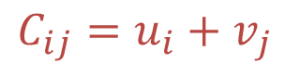
Problem 1: Optimal Solution by MODI Method
Initial solution obtained by the North West Corner Method:
To
P
Q
R
S
Supply
u_{i}
From
Check total number of allocation = m + n – 1
where m =number of rows and n = number of columns
180
150
170
A
500
u₁
12
10
12
13
180
120
B
300
u₂
Here 3+4-1 = 6 = Total allocations
7
11
8
14
200
Find u_{i} & v_{j} co-efficients from all the allocated cells by using the following formula
C
200
u₃
6
16
11
7
Demand
180
150
350
320
$$C_{ij}=u_{i}+v_{j}$$
v_{j}
v₁
v₂
v₃
v₄
In order to find u_{i} & v_{j} one has to take value of any one of the coefficient equal to zero.
Generally we will consider row or column having maximum allocations in it and make its coefficient value to zero.

Slide 33
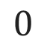
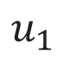
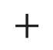
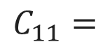
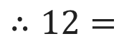
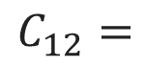
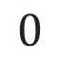
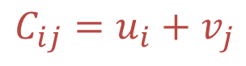
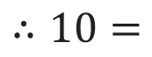
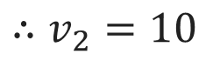
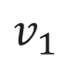
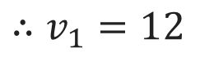
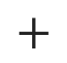
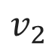
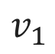
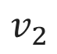



Problem 1: Optimal Solution by MODI Method
Here first row is having 3 allocations so we will take u₁ = 0.
To
P
Q
R
S
Supply
u_{i}
From
Now find all the remaining u_{i} and v_{j} from allocated cells using following equation:
180
150
170
A
u₁
500
u₁ = 0
12
10
12
13
180
120
$$C_{ij}=u_{i}+v_{j}$$
B
300
u₂
7
11
8
14
For cell AP
200
C
200
u₃
$$C_{11}=$$
$$u_{1}$$
$$+$$
$$v_{1}$$
6
16
11
7
$$∴12=$$
$$0$$
$$+$$
$$v_{1}$$
Demand
180
150
350
320
$$∴v_{1}=12$$
v_{j}
v₁
v₁ = 12
v₂
v₂ = 10
v₃
v₄
For cell AQ
$$C_{12}=$$
$$u_{1}$$
$$+$$
$$v_{2}$$
$$∴10=$$
$$0$$
$$+$$
$$v_{2}$$
$$∴v_{2}=10$$

Slide 34

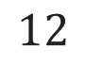
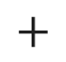
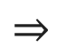
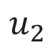
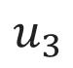
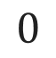
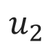

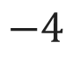
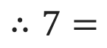
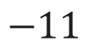

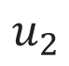
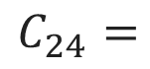
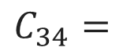
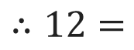
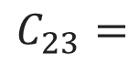
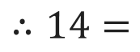
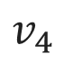
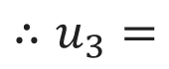

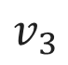
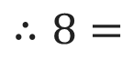
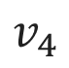
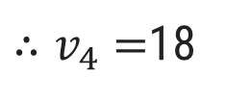
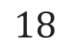
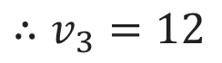











Problem 1: Optimal Solution by MODI Method
For cell AR
To
$$C_{13}=$$
$$u_{1}$$
$$+$$
$$v_{3}$$
P
Q
R
S
Supply
u_{i}
From
$$∴12=$$
$$0$$
$$+$$
$$v_{3}$$
180
150
170
$$∴v_{3}=12$$
A
500
u₁ = 0
12
10
12
13
For cell BR
180
120
u₂
B
300
u₂ = -4
$$C_{23}=$$
$$u_{2}$$
$$+$$
$$v_{3}$$
7
11
8
14
$$∴8=$$
$$u_{2}$$
$$+$$
$$12$$
200
u₃ = -11
C
200
u₃
$$∴u_{2}=−4$$
6
16
11
7
For cell BS
Demand
180
150
350
320
$$C_{24}=$$
$$u_{2}$$
$$+$$
$$v_{4}$$
v_{j}
v₁ = 12
v₂ = 10
v₃ = 12
v₄ = 18
v₃
v₄
$$∴14=$$
$$−4$$
$$+$$
$$v_{4}$$
$∴v_{4}=$18
For cell BS
$$C_{34}=$$
$$u_{3}$$
$$+$$
$$v_{4}$$
$$⇒$$
$$∴7=$$
$$u_{3}$$
$$+$$
$$18$$
$$⇒$$
$$∴u_{3}=$$
$$−11$$

Slide 35














Problem 1: Optimal Solution by MODI Method
Calculate opportunity cost for all the unallocated cells as below:
To
P
Q
R
S
Supply
u_{i}
Opportunity Cost
$$=C_{ij}−(u_{i}+v_{j})$$
From
180
150
170
For cell AS
A
500
u₁ = 0
12
10
12
-5
13
Opportunity Cost
$$=C_{14}−(u_{1}+v_{4})$$
180
120
B
300
u₂ = -4
$$=13−(0+18)$$
-1
7
5
11
8
14
$∴$ Opportunity Cost
$$=−5$$
200
C
200
u₃ = -11
For cell BP
6
16
11
7
Opportunity Cost
Demand
180
150
350
320
$$=C_{21}−(u_{2}+v_{1})$$
$$=7−(−4+12)$$
v_{j}
v₁ = 12
v₂ = 10
v₃ = 12
v₄ = 18
$∴$ Opportunity Cost
$$=−1$$
For cell BQ
Opportunity Cost
$$=C_{22}−(u_{2}+v_{2})$$
$$=11−(−4+10)$$
$$⇒$$
$∴$ Opportunity Cost
$$=5$$

Slide 36

















Problem 1: Optimal Solution by MODI Method
$$+$$
For cell CP
To
P
Q
R
S
Supply
u_{i}
Opportunity Cost
$$=C_{31}−(u_{3}+v_{1})$$
From
180
150
170
$$+$$
$$=6−(−11+12)$$
A
$$−$$
500
u₁ = 0
12
10
12
-5
13
$∴$ Opportunity Cost
$$=5$$
180
120
For cell CQ
B
300
u₂ = -4
-1
7
5
11
8
14
$$+$$
$$−$$
Opportunity Cost
$$=C_{32}−(u_{3}+v_{2})$$
200
C
200
u₃ = -11
$$=16−(−11+10)$$
5
6
17
16
10
11
7
$∴$ Opportunity Cost
$$=17$$
Demand
180
150
350
320
For cell CR
v_{j}
v₁ = 12
v₂ = 10
v₃ = 12
v₄ = 18
Opportunity Cost
$$=C_{33}−(u_{3}+v_{3})$$
$$=11−(−11+12)$$
$∴$ Opportunity Cost
$=1$0

Slide 37
Problem 1: Optimal Solution by MODI Method
To
P
Q
R
S
Supply
From
180
150
170-120
0+120
A
500
12
10
12
13
180+120
120-120
B
300
7
11
8
14
200
C
200
6
16
11
7
Demand
180
150
350
320

Slide 38


Problem 1: Optimal Solution by MODI Method
Revised solution obtained in previous step.
Check total number of allocation = m + n - 1
Find u_{i} & v_{j} values first and after that find opportunity cost for all the unallocated cells.
To
P
Q
R
S
Supply
u_{i}
For allocated cells:
From
180
150
50
120
$$C_{ij}=u_{i}+v_{j}$$
A
–
+
500
u₁ = 0
12
10
12
13
+
300
For unallocated cells:
B
–
300
u₂ = -4
-1
7
5
11
8
5
14
Opportunity Cost
200
C
200
u₃ = -6
0
6
12
16
5
11
7
$$=C_{ij}−(u_{i}+v_{j})$$
Demand
180
150
350
320
v_{j}
v₁ = 12
v₂ = 10
v₃ = 12
v₄ = 13

Slide 39
Problem 1: Optimal Solution by MODI Method
To
P
Q
R
S
Supply
From
180-180
150
50+180
120
A
–
500
+
12
10
12
13
0+180
300-180
B
+
300
7
11
–
8
14
200
C
200
6
16
11
7
Demand
180
150
350
320

Slide 40
Problem 1: Optimal Solution by MODI Method
Revised solution obtained in previous step.
Check total number of allocation = m + n - 1
Find u_{i} & v_{j} values first and after that find opportunity cost for all the unallocated cells.
To
P
Q
R
S
Supply
u_{i}
For allocated cells:
From
150
230
120
$$C_{ij}=u_{i}+v_{j}$$
A
500
u₁ = 0
1
12
10
12
13
180
120
For unallocated cells:
B
300
u₂ = -4
7
5
11
8
5
14
Opportunity Cost
200
C
200
u₃ = -6
1
6
12
16
5
11
7
$$=C_{ij}−(u_{i}+v_{j})$$
Demand
180
150
350
320
v_{j}
v₁ = 11
v₂ = 10
v₃ = 12
v₄ = 13

Slide 41
Problem 1: Optimal Solution by MODI Method
To
P
Q
R
S
Supply
u_{i}
From
150
230
120
A
500
u₁ = 0
1
12
10
12
13
180
120
B
300
u₂ = -4
7
5
11
8
5
14
200
C
200
u₃ = -6
1
6
12
16
5
11
7
Demand
180
150
350
320
v_{j}
v₁ = 11
v₂ = 10
v₃ = 12
v₄ = 13
Hear all the unallocated cells are having non-negative opportunity cost so obtained solution is optimal.
Optimal transportation Cost
= (10x150)
+ (12x230) +
(13x120)
+ (7x180)
+ (8x120)
+ (7x200)
= ₹9,440

Slide 42
Variations in Transportation Problems
Section – 2.4

Slide 43
Problem 2
A data center company has received a contract to supply servers for three new projects located in cities A, B and C. Engineers have estimated the required number of servers for each projects:
Project Location | Requirement (servers)
A | 144
B | 204
C | 82
The company has three server warehouses located in towns W, X and Y respectively. The servers required by the projects can be supplied by these three warehouses. The number of servers which can be supplied by each warehouse is given in the table.
Warehouses | W | X | Y
No. of Servers Available | 152 | 164 | 154
The company has computed the delivery cost from each warehouse to each project site. These costs (in rupees) are shown in the table.
Warehouse | A | B | C
W | 8 | 16 | 16
X | 32 | 48 | 32
Y | 16 | 32 | 48
Schedule the shipment from each warehouse to each project in such a manner so as to minimize the total transportation cost within the constraints imposed by warehouse capacities and project requirements. Find the minimum cost.

Slide 44
Problem 2: Unbalanced Transportation Problem
First check if given problem is balanced by calculating total supply and total demand.
Supply
Requirement
W – 152
A – 144
X – 164
B – 204
Y – 154
C – 82
470
430
+
Dummy 40
470
To balance supply and demand we have to add dummy site with requirement of 40 servers.
After adding dummy requirement of 40, total supply and total demand are equal so given problem is balanced and we can find initial solution.
As this site is actually not present so transportation cost to this site from any warehouse is zero.

Slide 45
Problem 2: Unbalanced Transportation Problem
Initial Solution by Vogel’s Approximation Method
To
A
B
C
Dummy
Supply
Penalty
From
152
152
0
8
8
W
8
16
16
0
42
82
40
164
124
32
0
0
X
32
48
32
0
42
0
16
144
10
154
10
16
16
16
Y
16
32
48
0
0
16
144
0
204
52
82
0
40
0
Demand
42
0
8
16
16
16
16
0
Penalty
8
16
16
16
16
16

Slide 46


Problem 2: Unbalanced Transportation Problem
Optimal solution by MODI method:
To
A
B
C
Dummy
Supply
u_{i}
Initial solution obtained by VAM:
From
152
First check that
W
152
u₁ = 16
8
8
16
16
16
32
0
total allocations = m + n – 1
42
82
40
X
164
u₂ = 48
0
32
48
32
0
= 3 + 4 – 1 = 6
144
10
Now calculate values of u_{i} & v_{j} coefficients from the allocated cells using following formula.
Y
32
16
154
u₃ = 32
16
32
48
0
Demand
144
204
82
40
$$C_{ij}=u_{i}+v_{j}$$
To check optimality we have to find opportunity cost for all the unallocated cells by using following formula
v_{j}
v₁ = -16
v₂ = 0
v₃ = -16
v₄ = -48
$${\text{Opportunity} \text{cost}=C}_{ij}−{(u}_{i}+v_{j})$$

Slide 47
Problem 2: Unbalanced Transportation Problem
To
Here all the unallocated cells are having non-negative opportunity costs so obtained solution is optimal.
A
B
C
Dummy
Supply
u_{i}
From
152
W
152
u₁ = 16
8
8
16
16
16
32
0
42
82
40
Optimal transportation cost
X
164
u₂ = 48
0
32
48
32
0
= (152 x 16) +
(42 x 48) +
(82 x 32)
144
10
Y
32
16
154
u₃ = 32
+ (40 x 0) +
(144 x 16) +
(10 x 32)
16
32
48
0
Demand
144
204
82
40
= ₹9,696
v_{j}
v₁ = -16
v₂ = 0
v₃ = -16
v₄ = -48

Slide 48
Problem 3 Degeneracy at Initial Level
A manufacturing company has three plants X, Y and Z, which supply to the distributors located at A, B, C, D and E. Monthly plant capacities are 80, 50 and 90 units respectively. Monthly requirements of distributors are 40, 40, 50, 40 and 80 units respectively. Unit transportation costs are given below in rupees.
From | To
 | A | B | C | D | E
X | 5 | 8 | 6 | 6 | 3
Y | 4 | 7 | 7 | 6 | 6
Z | 8 | 4 | 6 | 6 | 3
Determine an optimal distribution for the company in order to minimize the total transportation cost.

Slide 49
Problem 3
First check if the given problem is balanced by calculating total supply and total demand.
Supply
Requirement
X – 80
A – 40
Y – 50
B – 40
Z – 90
C – 50
220
D – 40
+
Dummy 30
E – 80
250
250
To balance supply and demand we have to add dummy supply with 30 units.
After adding dummy supply of 30, total supply and total demand are equal so given problem is balanced and we can find initial solution.

Slide 50
Initial Solution by Vogel’s Approximation Method
To
A
B
C
D
E
Supply
Penalty
From
50
30
80
50
2
2
2
X
5
8
6
6
3
0
2
1
0
40
10
50
10
2
2
2
Y
4
7
7
6
6
0
2
2
1
40
50
90
50
1
1
3
Z
8
4
6
6
3
0
30
30
0
0
Dummy
0
0
0
0
0
40
0
40
0
50
0
40
10
80
30
Demand
0
0
4
1
4
6
1
6
0
3
3
Penalty
1
1
3
0
1
0
0
0
1
0
1
0
0
0

Slide 51
Optimal solution by MODI method:
To
A
B
C
D
E
Supply
Initial Solution obtained by Vogel’s Approximation Method
From
50
30
X
80
5
8
6
6
3
Here total allocations = 7,
m + n – 1 = 8
40
10
Y
50
$$total allocations≠m+n−1$$
4
7
7
6
6
40
50
This kind of situation is called degeneracy.
Z
90
8
4
6
6
3
Here we can not find all u_{i} & v_{j} values.
ε
30
Dummy
30
To resolve degeneracy we have to allocate an infinitesimally small quantity ε (epsilon) as one of the allocations.
0
0
0
0
0
Demand
40
40
50
40
80
For allocation of ε vacant cell/cells with least cost are chosen, and no closed loop of cell with ε can be formed.
If a loop is formed the cell/cells with next lower cost is/are chosen so that no loop is formed among them.
Now, total allocations = 8 = (m + n – 1)

Slide 52


To
Find u_{i} & v_{j} from all the allocated cells using following formula.
A
B
C
D
E
Supply
u_{i}
From
50
30
X
1
4
0
80
u₁ = 0
5
8
6
6
3
$$C_{ij}=u_{i}+v_{j}$$
40
10
Find opportunity cost for all the unallocated cells using following formula.
Y
3
10
3
50
u₂ = 0
4
7
7
6
6
40
50
Z
4
0
0
90
u₃ = 0
8
4
6
6
3
$$Opp. Cost.=C_{ij}−(u_{i}+v_{j})$$
ε
30
Dummy
2
2
3
30
u₄ = -6
Here all the unallocated cells are having non-negative opportunity costs so obtained solution is optimal.
0
0
0
0
0
Demand
40
40
50
40
80
v_{j}
v₁ = 4
v₂ = 4
v₃ = 6
v₄ = 6
v₅ = 3
Optimal transportation cost
= (50 x 6) +
(30 x 3) +
(40 x 4) +
(10 x 6) +
(40 x 4) +
(50 x 3) +
(ε x 0) +
(30 x 0)
=
₹920

Slide 53
Problem 4 Degeneracy at Optimal Level
An IT service company has technicians available at 4 different locations in the following number:
Location A – 5 technicians, Location B – 10 technicians, Location C – 7 technicians, Location D – 3 technicians.
Three client companies W, X and Y require technicians as shown:
Client W – 5 technicians, Client X – 8 technicians, Client Y – 10 technicians.
Variable costs getting technicians to the clients are:
From A to W – Rs. 7, to X – Rs. 3, to Y – Rs. 6
From B to W – Rs. 4, to X – Rs. 6, to Y – Rs. 8
From C to W – Rs. 5, to X – Rs. 8, to Y – Rs. 4
From D to W – Rs. 8, to X – Rs. 4, to Y – Rs. 3
Determine an optimal assignment of technicians from the locations to the clients to minimize the total cost.

Slide 54
Problem 4
First check if given problem is balanced by calculating total supply and total demand.
Supply
Requirement
A – 5
W – 5
B – 10
X – 8
C – 7
Y – 10
D – 3
23
+
25
Dummy 2
25
To balance supply and demand we have to add dummy requirement with 2 technicians.
After adding dummy requirement of 2, total supply and total demand are equal so given problem is balanced and we can find initial solution.

Slide 55
Initial Solution by Vogel’s Approximation Method
To
W
X
Y
Dummy
Supply
Penalty
From
5
5
0
3
3
A
7
3
6
0
5
3
2
10
5
4
2
2
2
2
B
4
6
8
0
2
0
5
2
7
5
4
1
1
4
C
5
8
4
0
0
3
3
0
3
1
1
1
1
D
8
4
3
0
5
0
8
3
10
5
2
0
Demand
0
2
0
1
1
2
1
1
0
Penalty
1
1
2
1
5
1
2
1

Slide 56






Optimal solution by MODI method:
Initial Solution obtained by Vogel’s Approximation Method.
Here total allocations = 7,
m + n – 1 = 7
$$total allocations=m+n−1$$
So obtained initial solution can be checked for optimality.
To
Find u_{i} & v_{j} from all the allocated cells using following formula.
W
X
Y
Dummy
Supply
u_{i}
From
5
A
5
u₁ = -3
6
7
3
1
6
-1
0
$$C_{ij}=u_{i}+v_{j}$$
5
3
2
B
$$−$$
-4
$$+$$
10
u₂ = 0
Find opportunity cost for all the unallocated cells using following formula.
4
6
8
0
5
2
C
5
6
7
u₃ = -4
5
8
4
$$−$$
$$+$$
0
3
$$Opp. Cost.=C_{ij}−(u_{i}+v_{j})$$
D
3
u₄ = -5
9
8
3
4
3
1
0
Cell (C, Dummy) has maximum opportunity cost of 4. Loop for this cell is shown in the table.
Demand
5
8
10
2
v_{j}
v₁ = 4
v₂ = 6
v₃ = 8
v₄ = 4

Slide 57




To
u_{i}
W
X
Y
Dummy
Supply
From
5
A
5
u₁ = -3
6
7
3
1
6
-1
0
5
3
2 – 2
0 + 2
B
$$−$$
$$+$$
10
u₂ = 0
4
6
8
-4
0
5 + 2
2 – 2
C
7
u₃ = -4
5
5
6
8
4
$$−$$
$$+$$
0
3
D
3
u₄ = -5
9
8
3
4
3
1
0
Demand
5
8
10
2
v_{j}
v₁ = 4
v₂ = 6
v₃ = 8
v₄ = 4

Slide 58








To
Revised solution
W
X
Y
Dummy
Supply
u_{i}
From
Here,
5
A
5
u₁ = -3
$$total allocations≠m+n−1$$
6
7
3
5
6
3
0
5
3
2
There is degeneracy in this revised solution. So we can not find all u_{i} & v_{j} values.
B
$$−$$
$$+$$
10
u₂ = 0
4
6
4
8
0
7
ε
C
1
2
7
u₃ = 0
5
8
$$+$$
4
0
To resolve degeneracy allocation of ε must be done.
$$−$$
3
D
3
u₄ = -1
5
8
-1
4
3
1
0
In this case for allocation of ε priority should be given to recently vacated cells which having least cost and no loop of ε should form.
$$+$$
$$−$$
Demand
5
8
10
2
v_{j}
v₁ = 4
v₂ = 6
v₃ = 4
v₄ = 0
Find u_{i} & v_{j} from all the allocated cells.
$$C_{ij}=u_{i}+v_{j}$$
Find opportunity cost for all the unallocated cells.
$$Opp. Cost.=C_{ij}−(u_{i}+v_{j})$$
Cell (D, X) has maximum opportunity cost of 1. Loop for this cell is shown in the table.

Slide 59






To
W
X
Y
Dummy
Supply
u_{i}
From
5
A
5
u₁ = -3
7
3
6
0
5
3-ε
2+ε
B
$$+$$
10
u₂ = 0
$$−$$
4
4
6
8
0
7+ε
ε-ε
C
7
u₃ = 0
5
2
8
$$+$$
4
0
$$−$$
ε
3-ε
D
3
u₄ = -1
8
4
3
0
$$+$$
$$−$$
Demand
5
8
10
2
v_{j}
v₁ = 4
v₂ = 6
v₃ = 4
v₄ = 0

Slide 60


To
Revised solution
W
X
Y
Dummy
Supply
u_{i}
From
Here,
5
A
5
u₁ = -3
total allocations =
m + n – 1 = 7
6
7
3
4
6
3
0
5
3-ε
2+ε
So obtained solution can be checked for optimality.
B
3
10
u₂ = 0
4
6
8
0
7+ε
Find u_{i} & v_{j} from all the allocated cells using following formula.
C
2
3
1
7
u₃ = -1
5
8
4
0
ε
3-ε
$$C_{ij}=u_{i}+v_{j}$$
D
3
u₄ = -2
6
8
4
3
2
0
Find opportunity cost for all the unallocated cells using following formula.
Demand
5
8
10
2
v_{j}
v₁ = 4
v₂ = 6
v₃ = 5
v₄ = 0
$$Opp. Cost.=C_{ij}−(u_{i}+v_{j})$$
Here all the unallocated cells are having non-negative opportunity costs so obtained solution is optimal.
Optimal transportation cost
= (5 x 3) +
(5 x 4) +
{(3-ε)x 6} +
{(2+ε)x 0} +
{(7+ε)x 4} +
(ε x 4) +
{(3-ε)x 3}
= ₹90

Slide 61
Problem 5 Restricted Route Problem
Find out optimal solution of given problem having restricted route.
From | To |  |  |  |  |  | Supply
 | 1 | 2 | 3 | 4 | 5 | 6
1 | 70 | 50 | 70 | 50 | 50 | 30 | 600
2 | 90 | 110 | 60 | 110 | - | 50 | 200
3 | 110 | 100 | 60 | 20 | 20 | 80 | 900
4 | 90 | 100 | 90 | 60 | 90 | 120 | 500
Demand | 600 | 200 | 400 | 200 | 400 | 400

Slide 62
Initial Solution by Vogel’s Approximation Method
To
1
2
3
4
5
6
Supply
Penalty
From
200
400
600
400
20
20
20
40
1
70
50
70
50
50
30
0
100
100
200
100
10
10
10
10
30
30
2
90
110
60
110
M
50
0
300
200
400
900
500
0
0
40
20
50
3
110
100
60
20
20
80
300
0
500
500
0
30
30
30
0
0
0
4
90
100
90
60
90
120
600
100
200
0
400
100
200
0
400
0
400
0
Demand
0
0
20
0
50
0
0
30
30
20
Penalty
20
0
0
30
30
30
20
20
0
30
20
20
0
20

Slide 63
Optimal solution by MODI method:
To
1
2
3
4
5
6
Supply
From
Initial Solution obtained by Vogel’s Approximation Method
200
ε
400
1
600
70
50
70
50
50
30
100
100
2
200
Here total allocations = 8,
90
110
60
110
M
50
m + n – 1 = 9
300
200
400
3
900
$$total allocations≠m+n−1$$
110
100
60
20
20
80
500
4
500
There is degeneracy in initial solution.
90
100
90
60
90
120
Demand
600
200
400
200
400
400
Here we can not find all u_{i} & v_{j} values
To resolve degeneracy we have to allocate an infinitesimally small quantity ε (epsilon) as one of the allocations. For allocation of ε vacant cell/cells with least cost are chosen, and no closed loop of cell with ε can be formed.
Now, total allocations = 9 = (m + n – 1)

Slide 64


Optimal solution by MODI method:
To
Find u_{i} & v_{j} from all the allocated cells using following formula.
1
2
3
4
5
6
Supply
u_{i}
From
$$+$$
200
ε
400
1
$$−$$
600
u₁ = 30
-50
70
50
-20
70
0
50
50
30
$$C_{ij}=u_{i}+v_{j}$$
100
100
Find opportunity cost for all the unallocated cells using following formula.
2
$$+$$
200
u₂ = 0
$$−$$
90
90
110
60
90
110
M
50
50
300
200
400
3
900
u₃ = 0
20
110
80
100
60
20
20
80
80
$$Opp. Cost.=C_{ij}−(u_{i}+v_{j})$$
$$−$$
$$+$$
500
4
500
u₄ = 0
Cell (1,1) has the maximum opportunity cost of 50.
90
80
100
30
90
40
60
70
90
120
120
Demand
600
200
400
200
400
400
v_{j}
v₁ = 90
v₂ = 20
v₃ = 60
v₄ = 20
v₅ = 20
v₆ = 0

Slide 65
To
1
2
3
4
5
6
Supply
u_{i}
From
ε
200
ε–ε
400
1
$$+$$
$$−$$
600
u₁ = 30
-50
70
50
-20
70
0
50
50
30
100–ε
100+ε
2
200
u₂ = 0
90
90
110
$$+$$
90
50
50
$$−$$
60
110
M
300–ε
200
400+ε
3
900
u₃ = 0
20
110
80
100
60
20
20
80
80
$$−$$
$$+$$
500
4
500
u₄ = 0
90
80
100
30
90
40
60
70
90
120
120
Demand
600
200
400
200
400
400
v_{j}
v₁ = 90
v₂ = 20
v₃ = 60
v₄ = 20
v₅ = 20
v₆ = 0

Slide 66
To
Revised solution
1
2
3
4
5
6
Supply
u_{i}
From
Here,
ε
200
400
1
600
u₁ = 0
total allocations =
m + n – 1
70
50
30
70
50
50
50
50
30
100
100
So obtained solution can be checked for optimality.
2
200
u₂ = 20
90
40
110
60
90
110
M
0
50
300
200
400
Find values of u_{i} & v_{j} from the allocated cells.
3
900
u₃ = 20
20
110
30
100
60
20
20
30
80
500
Find opportunity cost for all the unallocated cells.
4
500
u₄ = 20
90
30
100
30
90
40
60
70
90
70
120
Demand
600
200
400
200
400
400
Here all the unallocated cells are having non-negative opportunity costs so obtained solution is optimal.
v_{j}
v₁ = 70
v₂ = 50
v₃ = 40
v₄ = 0
v₅ = 0
v₆ = 30
Optimal transportation cost
= (ε x 70) +
(200 x 50) +
(400 x 30) +
(100 x 90) +
(100 x 60)
+ (300 x 60)
+ (200 x 20)
+ (400 x 20)
+ (500 x 90)
= ₹1,12,000

Slide 67
Problem 6 Maximization Problem
A company has four factories F₁, F₂, F₃ and F₄ manufacturing the same product. Production and raw material costs differ from factory to factory and are given in the following table in the first two rows. The transportation costs from the factories to the sales depots S₁, S₂, S₃ are also given. The last two columns in the table give the sales price and the total requirement at each depot. The production capacity of each factory is given in the last row.
 |  | F₁ | F₂ | F₃ | F₄ | Sales price/unit | Requirement
Production cost/unit |  | 15 | 18 | 14 | 13
Raw material cost/unit |  | 10 | 9 | 12 | 9
Transportation cost/unit | S₁ | 3 | 9 | 5 | 4 | 34 | 80
 | S₂ | 1 | 7 | 4 | 5 | 32 | 120
 | S₃ | 5 | 8 | 3 | 6 | 31 | 150
Supply |  | 10 | 150 | 50 | 100
Determine the most profitable production and distribution schedule and the corresponding profit. The deficit production should be taken to yield zero profit.

Slide 68
Problem 6
Supply
Requirement
F₁ – 10
S₁ – 80
F₂ – 150
S₂ – 120
F₃ – 50
S₃ – 150
F₄ – 100
350
310
+
Dummy 40
350
Here, requirement exceeds the supply so we have to add dummy location in the factory to supply 40 units.
This problem is of maximization so we have to make profit matrix from the given table.

Slide 69
Problem 6
Preparing profit table from the given data.
Profit =
Sales price
- Raw material cost
- Production cost
- Transportation cost
To
To
S₁
S₂
S₃
S₁
S₂
S₃
From
From
F₁
34-10-15-3=6
32-10-15-1=6
31-10-15-5=1
F₁
6
6
1
F₂
34-18-9-9=-2
32-18-9-7=-2
31-18-9-8=-4
F₂
-2
-2
-4
F₃
34-14-12-5=3
32-14-12-4=2
31-14-12-3=2
F₃
3
2
2
F₄
34-13-9-4=8
32-13-9-5=5
31-13-9-6=3
F₄
8
5
3
Dummy
0
0
0
Dummy
0
0
0

Slide 70
Problem 6
Prepare relative loss table
To prepare relative loss matrix identify maximum profit cell, deduct all cell values from the maximum profit value.
To
To
S₁
S₂
S₃
S₁
S₂
S₃
From
From
F₁
8 – 6
8 – 6
8 – 1
F₁
2
2
7
F₂
8 – (-2)
8 – (-2)
8 – (-4)
F₂
10
10
12
F₃
8 – 3
8 – 2
8 – 2
F₃
5
6
6
F₄
8 – 8
8 – 5
8 – 3
F₄
0
3
5
Dummy
8 – 0
8 – 0
8 – 0
Dummy
8
8
8

Slide 71
To
Initial solution: Vogel’s Approximation Method
S₁
S₂
S₃
Supply
Penalty
From
10
10
0
0
5
Total Allocations = m + n -1 = 7
F₁
2
2
7
60
So obtained solution can be checked for optimality.
90
60
150
0
2
2
2
F₂
10
10
12
0
50
50
0
1
0
0
0
F₃
5
6
6
80
20
100
20
3
2
2
F₄
0
3
5
0
40
40
0
0
0
0
0
Dummy
8
8
8
80
0
120
110
150
100
Demand
90
0
60
0
2
1
2
1
2
Penalty
1
1
3
1

Slide 72
Optimal solution by MODI method:
Here
To
Total Allocations = m + n -1 = 7
S₁
S₂
S₃
Supply
u_{i}
From
Find values of u_{i} & v_{j} from the allocated cells.
10
F₁
10
u₁ = 2
Find opportunity cost for all the unallocated cells.
3
2
2
3
7
90
60
F₂
150
u₂ = 10
3
10
10
12
Here all the unallocated cells are having non-negative opportunity costs so obtained solution is optimal.
50
F₃
50
u₃ = 4
4
5
2
6
6
80
20
Here in the obtained solution relative loss is minimum so at this point profit will be maximum.
For finding maximum profit allocation obtained in the solution is transferred to profit table and maximum profit will be calculated.
F₄
100
u₄ = 3
0
3
0
5
40
Dummy
40
u₅ = 6
5
8
2
8
8
Demand
80
120
150
v_{j}
v₁ = -3
v₂ = 0
v₃ = 2

Slide 73
Profit Table
To
S₁
S₂
S₃
Supply
From
10
F₁
10
6
6
1
90
60
F₂
150
-2
-2
-4
50
F₃
50
3
2
2
80
20
F₄
100
8
5
3
40
Dummy
40
0
0
0
Demand
80
120
150
Maximum Profit
= (10 x 6) +
(90 x -2) +
(60 x -4) +
(50 x 2) +
(80 x 8)
+ (20 x 5)
+ (40 x 0)
= ₹480

Slide 74


Thank You !

